Slide 1
DAIRY MANAGEMENT SYSTEM
Submitted by:
Swapnil Rohidas Tawhare
Sampada Dnyandev Shinde

Slide 2
INDEX
Introduction
Literature Survey
Key Observations
Proposed work : Tools/Platform and Languages
Results and Discussion
ER Diagram
Conclusion
Future Scope
References

Slide 3
INTRODUCTION
The mission of the Milk Production House Project is to create to communication between rural area people and dairy management.
Our main goal to develop this application to encourage a dairy industry.
DAIRY MILK MANAGEMENT SYSTEM is a software application to maintain day-to-day transactions in a Milk Distributor Office.
This software help to register all the suppliers, buyers details , purchase and sails details etc.,
This project is beneficial for new Milk Distributor to be start soon in the city.
They have big plan to collect the milks from many different sources and distribute the same for the Milk buyers.
To manage all these the required a full-fledged software which will take care all these.

Slide 4
Literature Survey

Slide 5
KEY OBJECTIVES

Slide 6
Proposed work : Tools/Platform and Languages
For Server Side :-
Minimum Hardware Requirement :
Processor 1.60GHz
RAM 512 MB
Hard Disk 40 GB
Minimum Software Requirement :
Front End Java 5.4.16
Back End My SQL 5.6.12
Operating System Window XP any Compatible OS
Web Server Apache 2.4.4
For Client Side:-
Minimum Hardware Requirement
Processor 1.60GHz
RAM 512 MB
Hard Disk 40 GB
Operating System Window XP or any Compatible Operating System
Browser Internet Explorer 6.0 or any Compatible browser

Slide 7
PROJECT SCOPE
Rural area people to give survive option.
Project provide regular basis salary.
Daily Inventory manage option.
Print Detail and report
Print receipt
Quick access of all records and details.

Slide 8
Benefits and Limitations of dairy management system
Limitations :-
Require Light Connection.
Computer must required.
Operator has good command on English and computer.
Benefits:-
Rural Area people Survive option.
Paperwork Reduction.
Improved Data Quality.
Reduce Transportation Expensive.
View Report daily basis.
Error Reduction

Slide 9
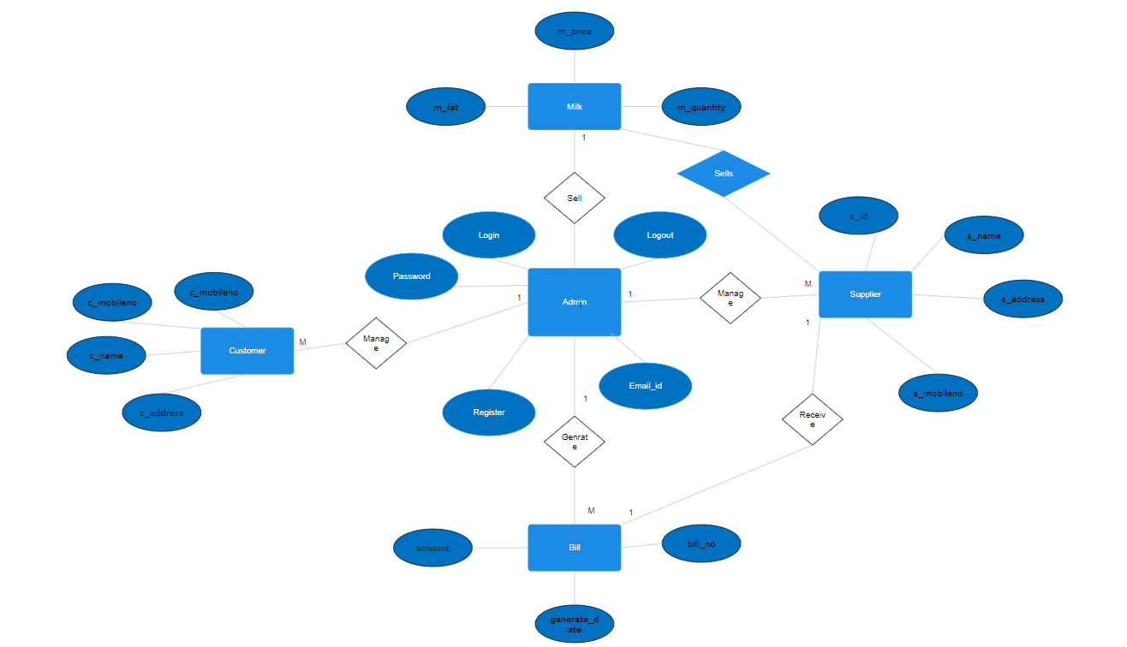
ER Diagram

Slide 10
Conclusion

Slide 11
Future Scope
Rural area people to give survive option.
Project provide regular basis salary.
Daily Inventory manage option.
Print Detail and report
Print receipt
Quick access of all records and details.

Slide 12
References
www.JavaTPoint.com
www.GeeksforGreeks.com
www.W3School.com
www.tutorialspoint.com

